Slide 1
Secure Data Hiding in Image Using Steganography
CAPSTONE PROJECT
Presented By:
Student Name : MUKUL SHARMA
College Name & Department :
MAHARAJA AGRASEN INSTITUTE OF TECHNOLOGY
(BTECH COMPUTER SCIENCE AND TECHNOLOGY)

Slide 2
OUTLINE
Problem Statement
Technology used
Wow factor
End users
Result
Conclusion
Git-hub Link
Future scope

Slide 3
Problem Statement
With the rise of digital communication, data security has become a major concern. This project focuses on embedding secret messages within images using steganography, ensuring secure data transmission without detection.

Slide 4
Technology used
Programming Language: Python
Libraries Used: OpenCV, os
Concepts: Image Processing, Pixel Manipulation, ASCII Encoding

Slide 5
Wow factors
Secret messages are embedded within image pixels using RGB channels.
A passcode-based decryption mechanism enhances security.
The system ensures that unauthorized users cannot retrieve the hidden data.
The process is seamless and does not distort the image significantly.

Slide 6
End users
Cybersecurity professionals
Digital forensic analysts
Individuals seeking secure communication
Journalists and activists needing confidential messaging

Slide 7
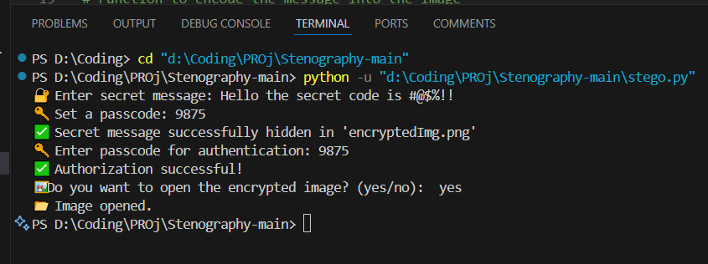
Results
Encrypting image and hiding secret message in it

Slide 8
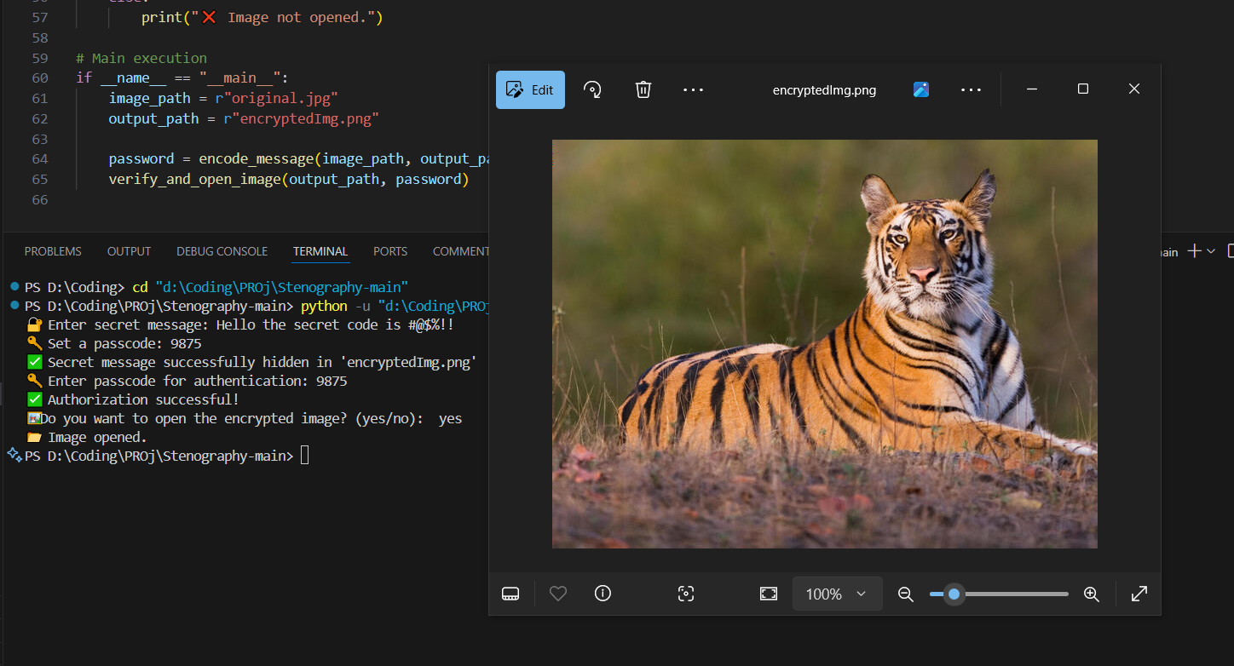
Encrypted image

Slide 9
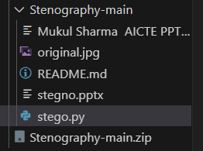
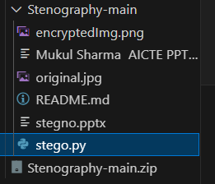
Folder before Encrypted Image
Folder after Encrypted Image

Slide 10
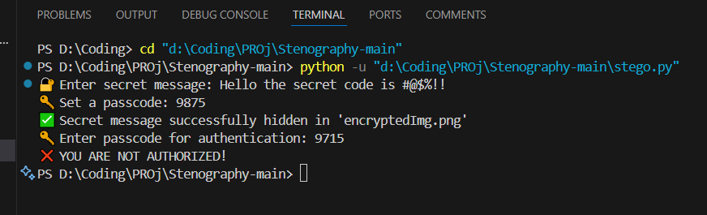
Authorization Failed

Slide 11
Conclusion
This project demonstrates a simple yet effective method for secure message transmission using image steganography. By embedding data at the pixel level and using a passcode for retrieval, the system ensures confidentiality and integrity.

Slide 12
GitHub Link
https://github.com/mukul-sharma-tech/AICTE-Internship-Mukul-Sharma

Slide 13
Future scope
Enhancing the algorithm to support multiple image formats and compression.
Implementing deep learning for automated steganalysis and detection prevention.
Developing a GUI-based application for user-friendly access.

Slide 14
THANK YOU

